Slide 1
MSDS 6306: Doing Data Science - Case Study 02
Ronak Hamzehlou

Slide 2
Summary
DDSAnalytics is an analytics company that specializes in talent management solutions for Fortune 100 companies, requested to classify factors that lead to attrition.

Slide 3
Factors Leading To Attrition
Employee who work over time have 33% higher attrition
Higher paid workers → lower attrition rate
Sales representatives → Higher attrition rate
Manufacturing Directors and Research Directors → Lower attrition rate

Slide 4
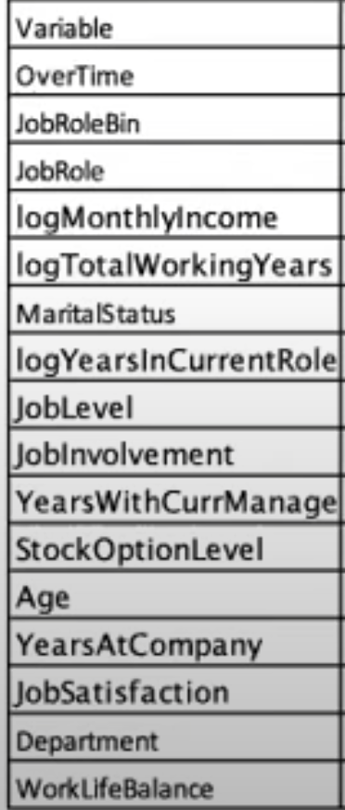
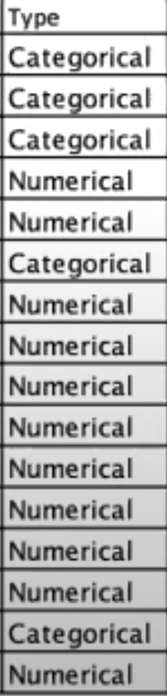
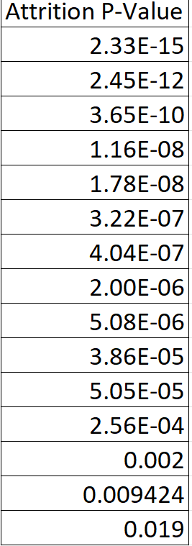
Factors Leading To Attrition

Slide 5
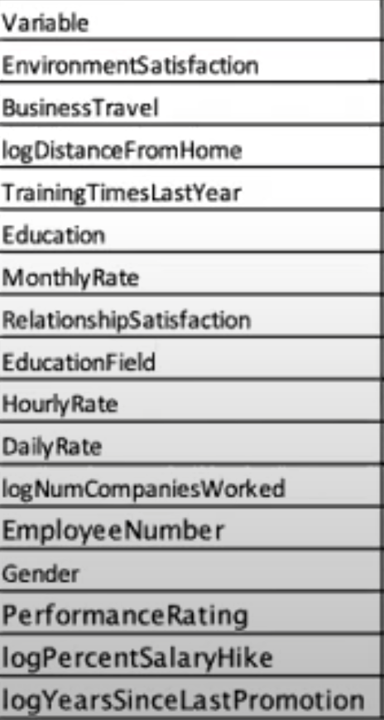
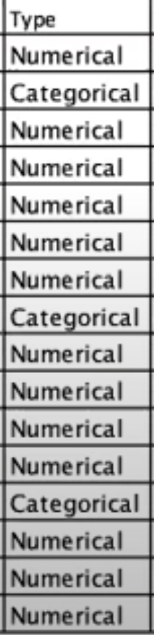
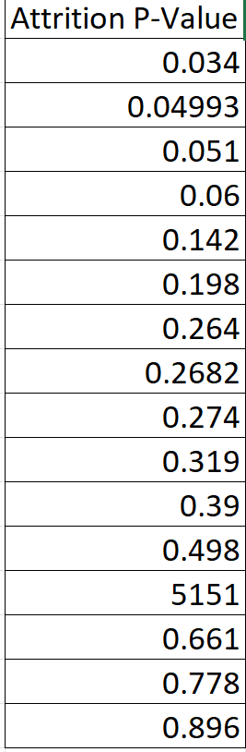
Factors Leading To Attrition

Slide 6
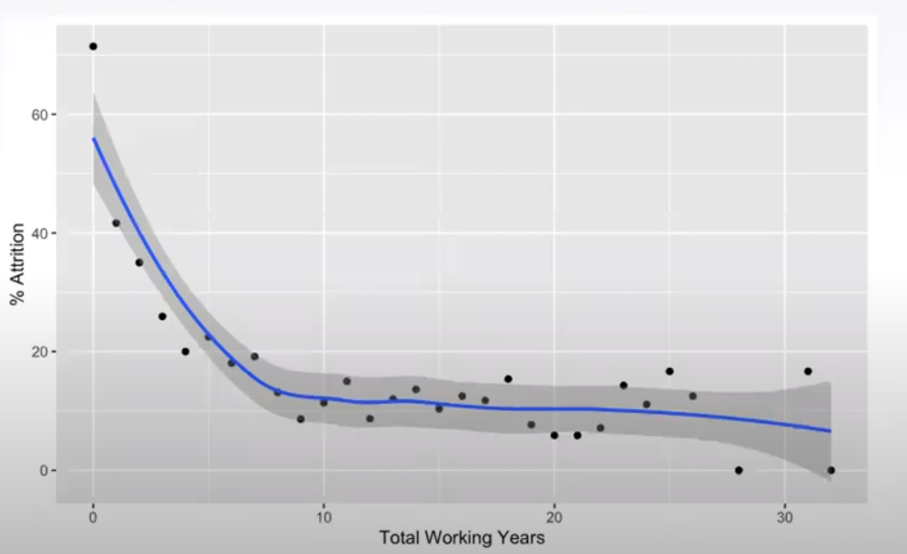
Factors Leading To Attrition
Attrition rates are higher for employees working less than 3 years (Work Experience)

Slide 7
Attrition Model- Naïve Bayes Using:
Over Time, Monthly Income, Material Status, Years In Current Role, Job Role, Age, Stock Option Level, Department, Business Travel, Distance From Home

Slide 8
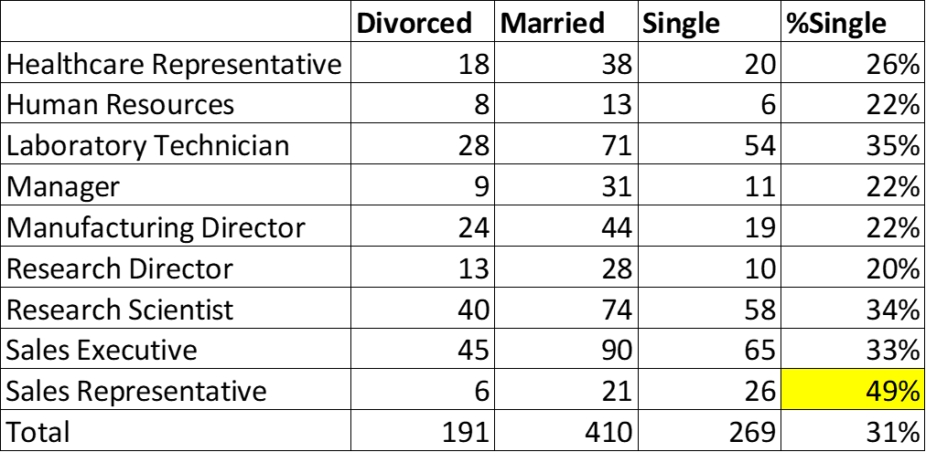
Job Role Observation
Sales Representative → Much more likely to be single (49%)

Slide 9
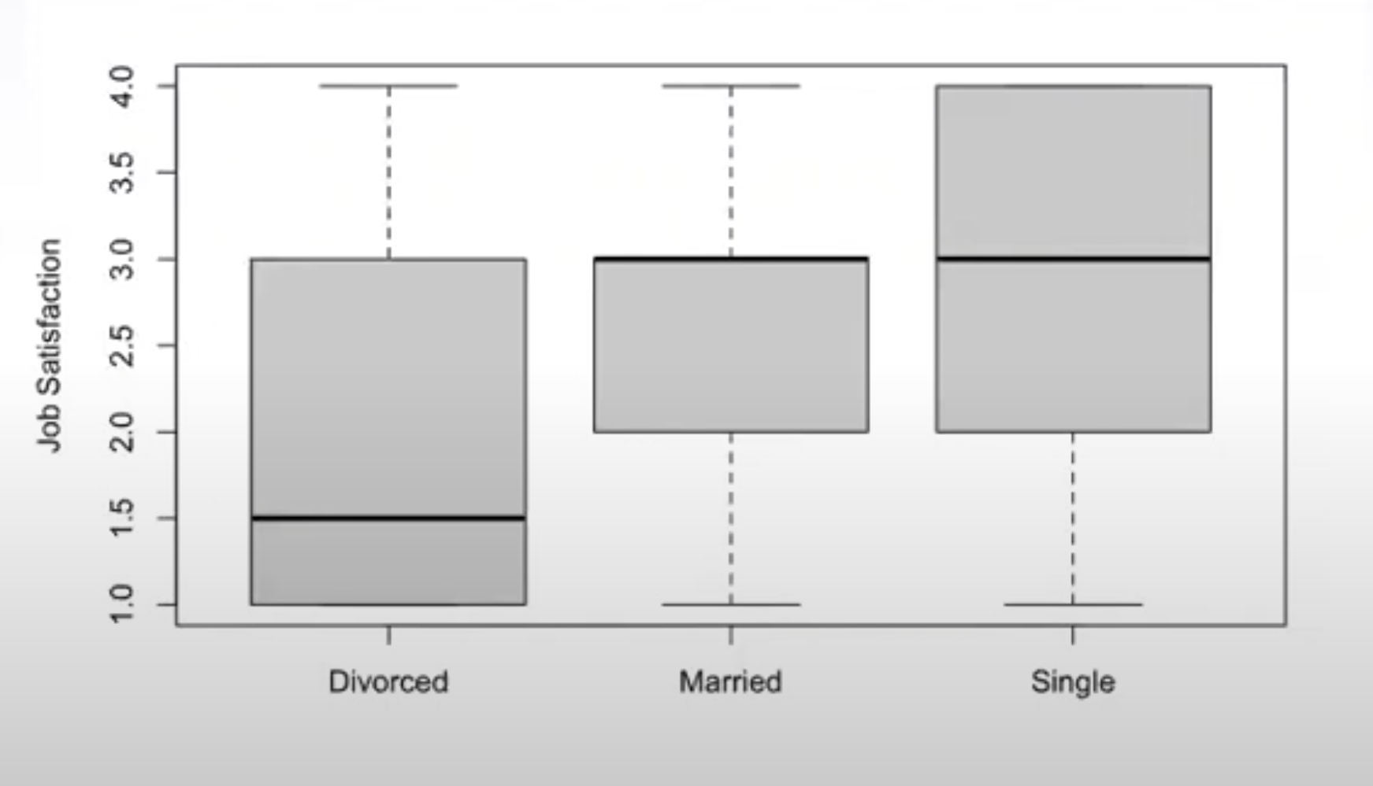
Job Role Observation
Sales Representatives (Married and/or Divorced) lower Job Satisfaction

Slide 10
Conclusion:
Would hiring and training more worker and reducing over time
Inexperienced workers have high attrition, maybe company can have more training for them
Higher pay reduces attrition rate
Representative gets married

Slide 11
Thank You!

